Slide 1
Going, Growing, Gone….
a New new ZEALAND emerges
Paul Spoonley Distinguished Professor Emeritus
ILANZ Conference 2024
“Te Punga Panoni – The Changemakers”
22 May 2024

Slide 2
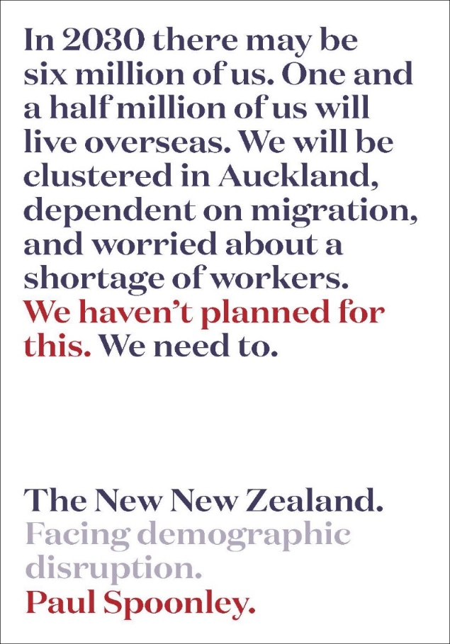
Why demography matters
Significant demographic differences are – and will – emerge in the next decade:
Generations
Regions
Māori, minority ethnic groups and immigrants
How will this impact on you, your work and your firm/organization?

Slide 3
Demographic transformation – a new Aotearoa/New Zealand

Slide 4
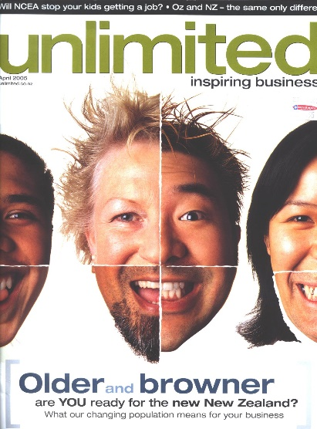
Demographic transformation – new zealand
Ageing population and declining fertility (doubling of 65+, sub-replacement fertility)
Ongoing urbanisation (with concentration in top of the North Island, Auckland effect - 40% of population by 2038)
Regional population stagnation/decline (many TAs will see the end of population growth)
Immigrant-led diversity (rapidly growing diversity plus Māori-led economic and cultural development)

Slide 5
#1 Why an ageing population – and workforce - matters

Slide 6
An oLD-DOMINANT population
Old-Dominant : more than 20% of a population or community over the age of 65 years. New Zealand will become old-dominant in next few years.
Entry : Exit Ratios : the numbers entering or exiting a workforce
Dependency Ratios : the ratio between those in paid work and those who on a benefit such as superannuation

Slide 7
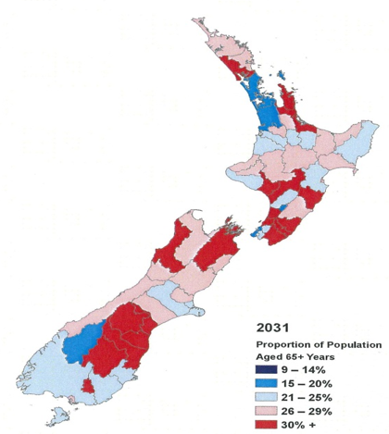
An Ageing population
Proportion of population aged 65+, by territorial authority area, mid-range projection 2031
Source: Statistics New Zealand

Slide 8
Labour market exit/entry – infometrics (2023)

Slide 9
#2 Generational shifts – and challenges

Slide 10
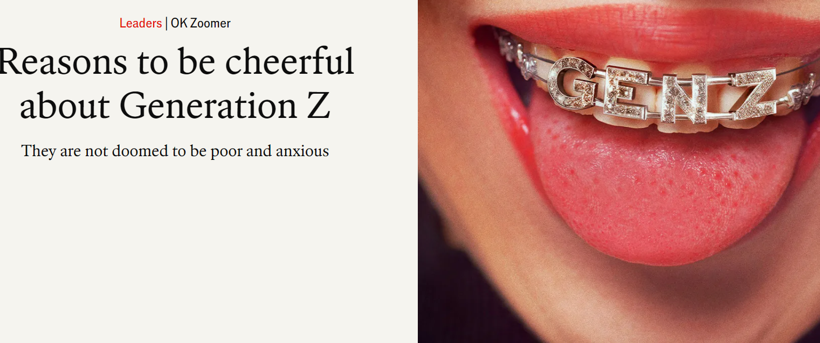
New generations – and values - arrive

Slide 11
New generations – and values - arrive

Slide 12
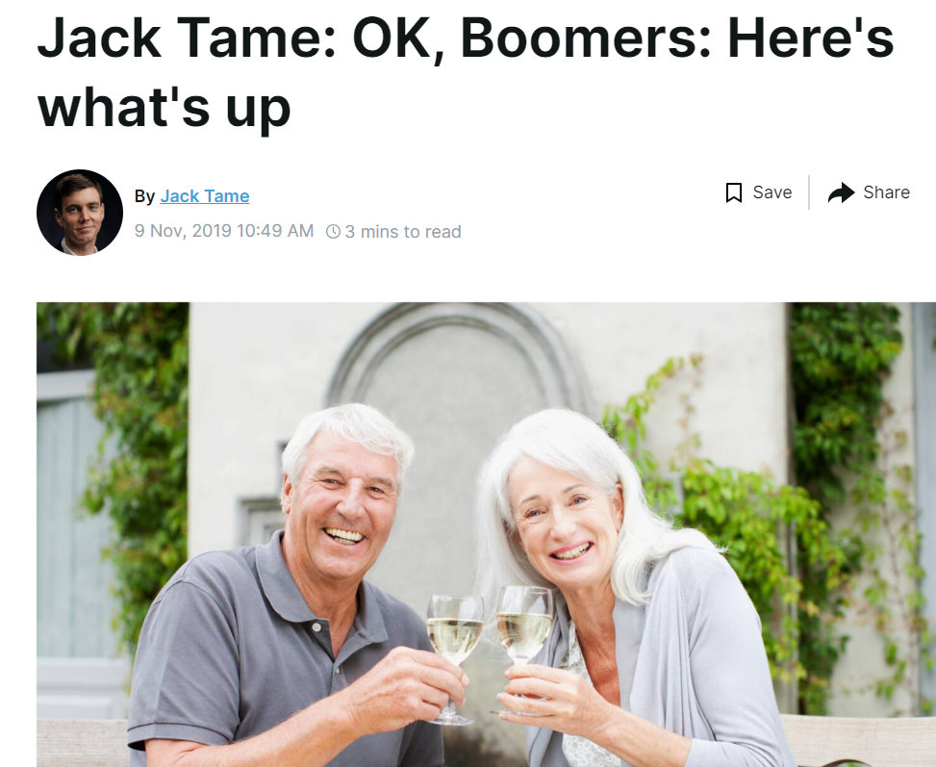
Intergenerational conversations

Slide 13
#3 The importance of gender – and the impacts of sub-replacement fertility

Slide 14
Sub-replacement fertility Low, Low Fertility Country?
1950s high (4.3 births per woman), hit sub-replacement rate in 2017 (now 1.56)
Delayed births plus none/”one and done” (Millennials)
Higher educational qualifications + jobs + cost of raising children alongside other costs such as housing
By 2030, 30,000 fewer school students in Aotearoa/New Zealand
Females now a significant part of paid workforce (50% of all those in paid work)

Slide 15
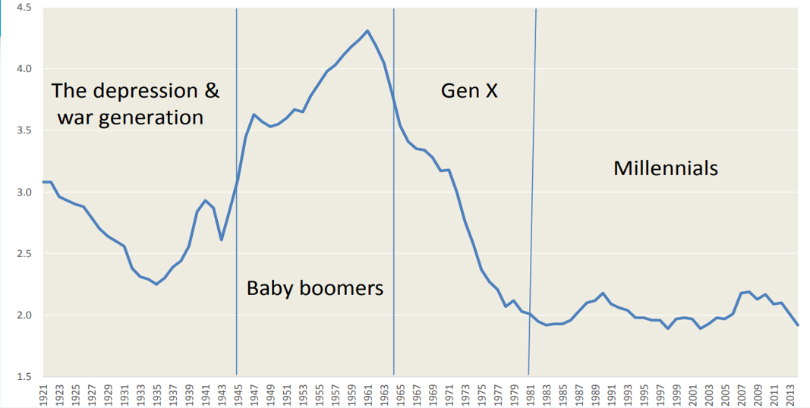
The collapse of fertility

Slide 16
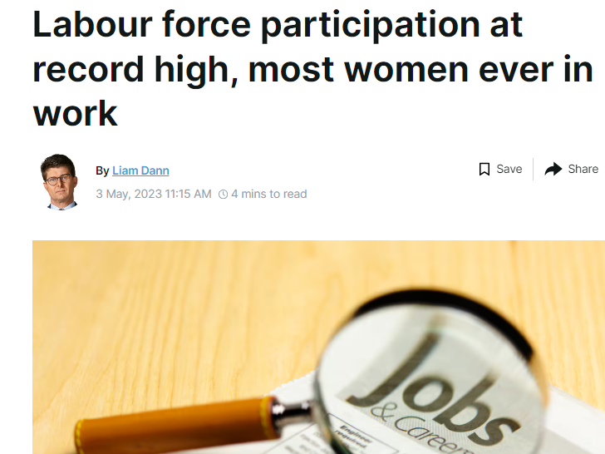
gender – and the workplace
Make gender visible. Firms that recognise gender are more socially responsible.
Tackle resistance
Make the business case for gender equality. Companies that are gender equal have a higher return on investment, higher job satisfaction and lower absenteeism.
Make it personal – why equality is good for everyone
Fiona Smith, Workplace Equality, The Guardian

Slide 17
#4 The growth – and growth – of the top of the North Island

Slide 18
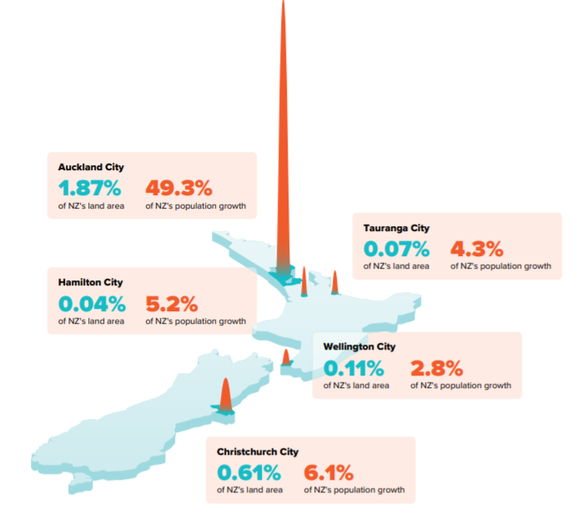
Growth centres in New Zealand over 2 decades

Slide 19
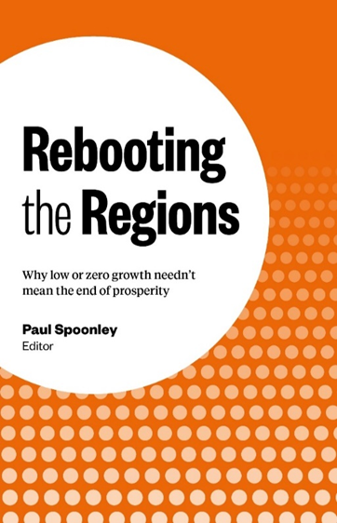
Ongoing urbanisation & regional stagnation
Two-thirds of regions in Aotearoa/New Zealand will experience ageing plus population stagnation or decline
Main regional towns will grow – Tauranga, Hastings, New Plymouth – but surrounding smaller towns and rural areas will stagnate – and some will see depopulation
Three-quarters of New Zealand’s population will live in the top half of the North island by 2040s
Auckland will be home to 40% of New Zealanders

Slide 20
#5 Superdiversity – and the ethnic diversification of Aotearoa New Zealand

Slide 21
MĀori – younger and growing fast
Māori still high fertility and still growing population (2%+ pa)
Fertility rate will drop but a young median age and higher fertility will see Māori dominate younger age groups
Parts of New Zealand – East Coast, Northland – will see Māori be the dominant group
21% of all New Zealanders will identify as Māori but 25% of workforce, 33% of all U15 year olds

Slide 22
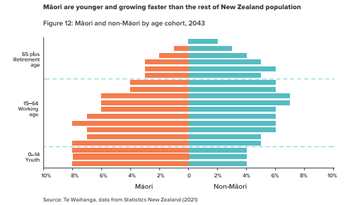
MĀori – younger and growing fast

Slide 23
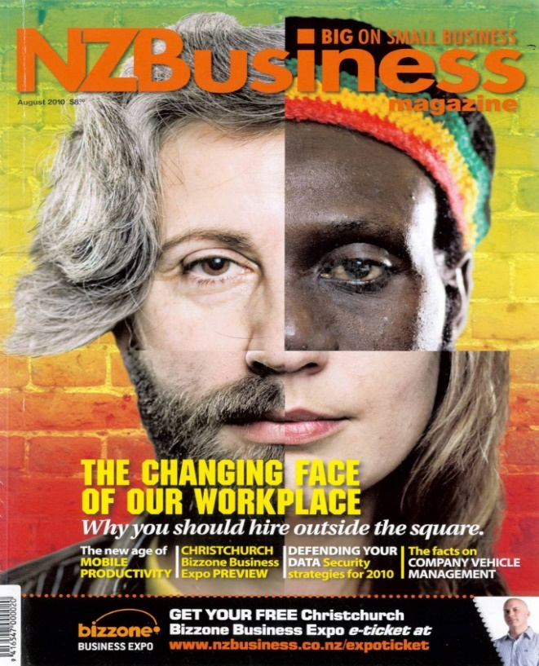
Immigration 2024
Permanent and long-term and temporary arrivals (February 2024)
Net Gain/Loss | +131,000
Arrivals | +253,200
Non-NZ Citizens | +178,600
NZ Citizens | -47,400

Slide 24
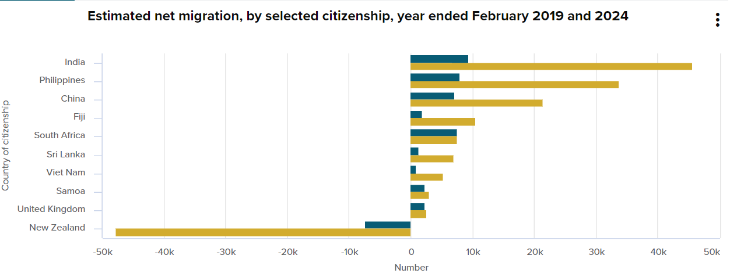
Superdiversity in new zealand 2024

Slide 25
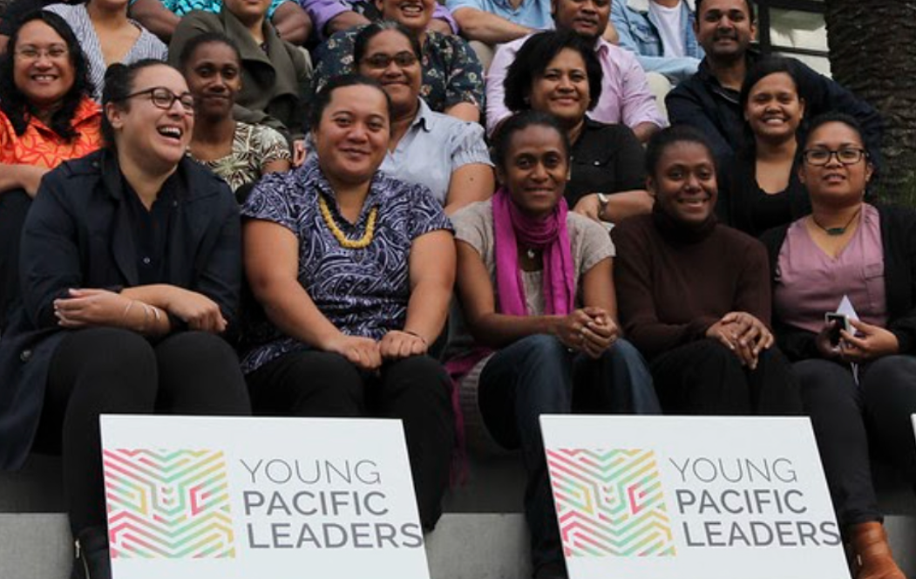
superdiversity (2013-2043)
0-14 Year Olds | 2013 | 2043 (% of total pop)
Māori | 25% | 33% (21%)
Asian | 12% | 25% (24%)
Pasifika | 13% | 19% (11%)

Slide 26
Responsiveness in a period of major demographic change

Slide 27
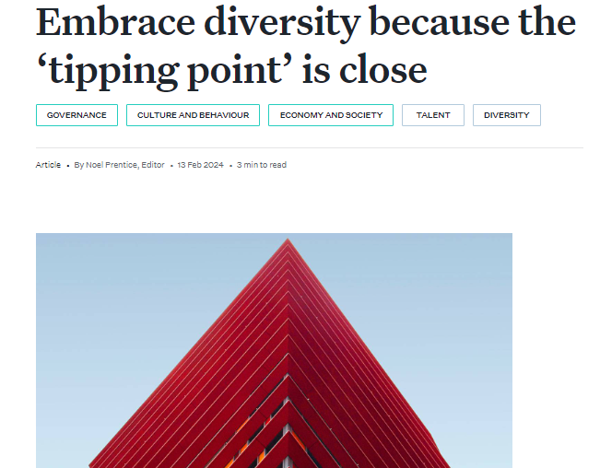
The growing significance of diversity

Slide 28
The growing significance of diversity

Slide 29
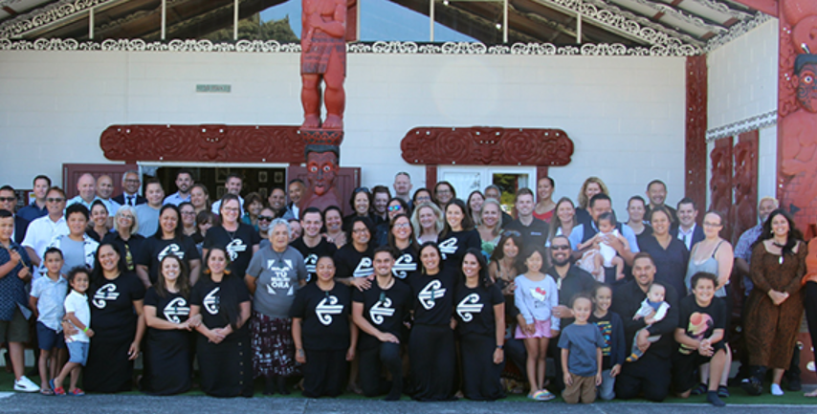
The growing significance of diversity

Slide 30
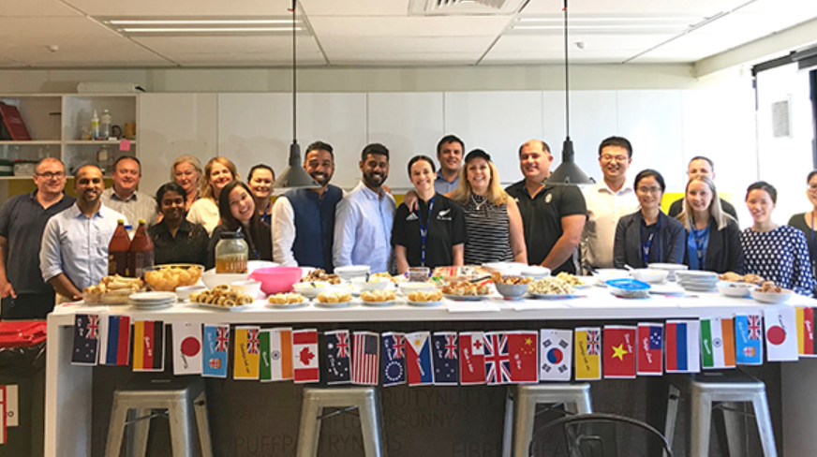
The growing significance of diversity

Slide 31
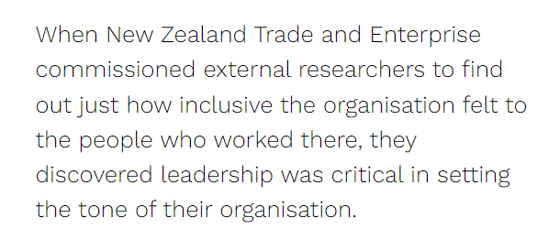
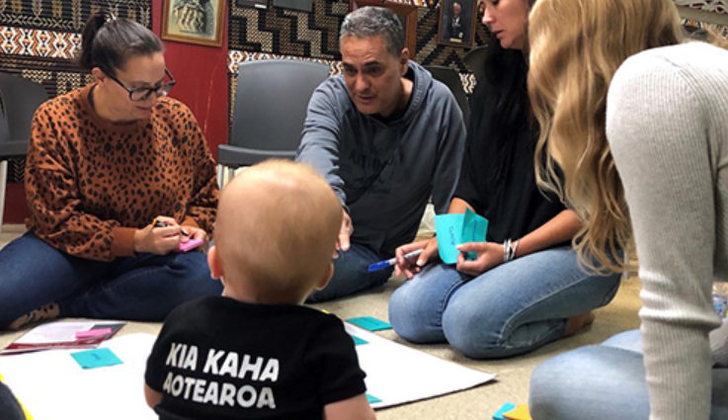
The growing significance of diversity

Slide 32
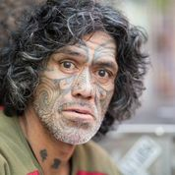
Anticipating the future : Demographic challenges
1. Large numbers exiting the workforce – and more over 65s remaining in the workforce. How will you respond to hyper-ageing?
2. 75% of the population will live in the top half of the North Island, 40% in Auckland. Where will your workers, suppliers and clients come from?
3. Gender and fertility become more important. How will you respond?
4. New Zealand will be much more superdiverse in the future. What does this mean for talent recruitment, clients and customers and markets?

