Slide 1
Contracting with Iwi or Kaupapa Māori Organisations
A Practical Session with Natasha Strong and Jason Cooper

Slide 2
Presentation Title
Notes:
Here is a link to the embedded video: https://youtu.be/dRYQVo0zbuQ?list=TLGGDOpxG1ur6wUyMDA1MjAyNA

Slide 3
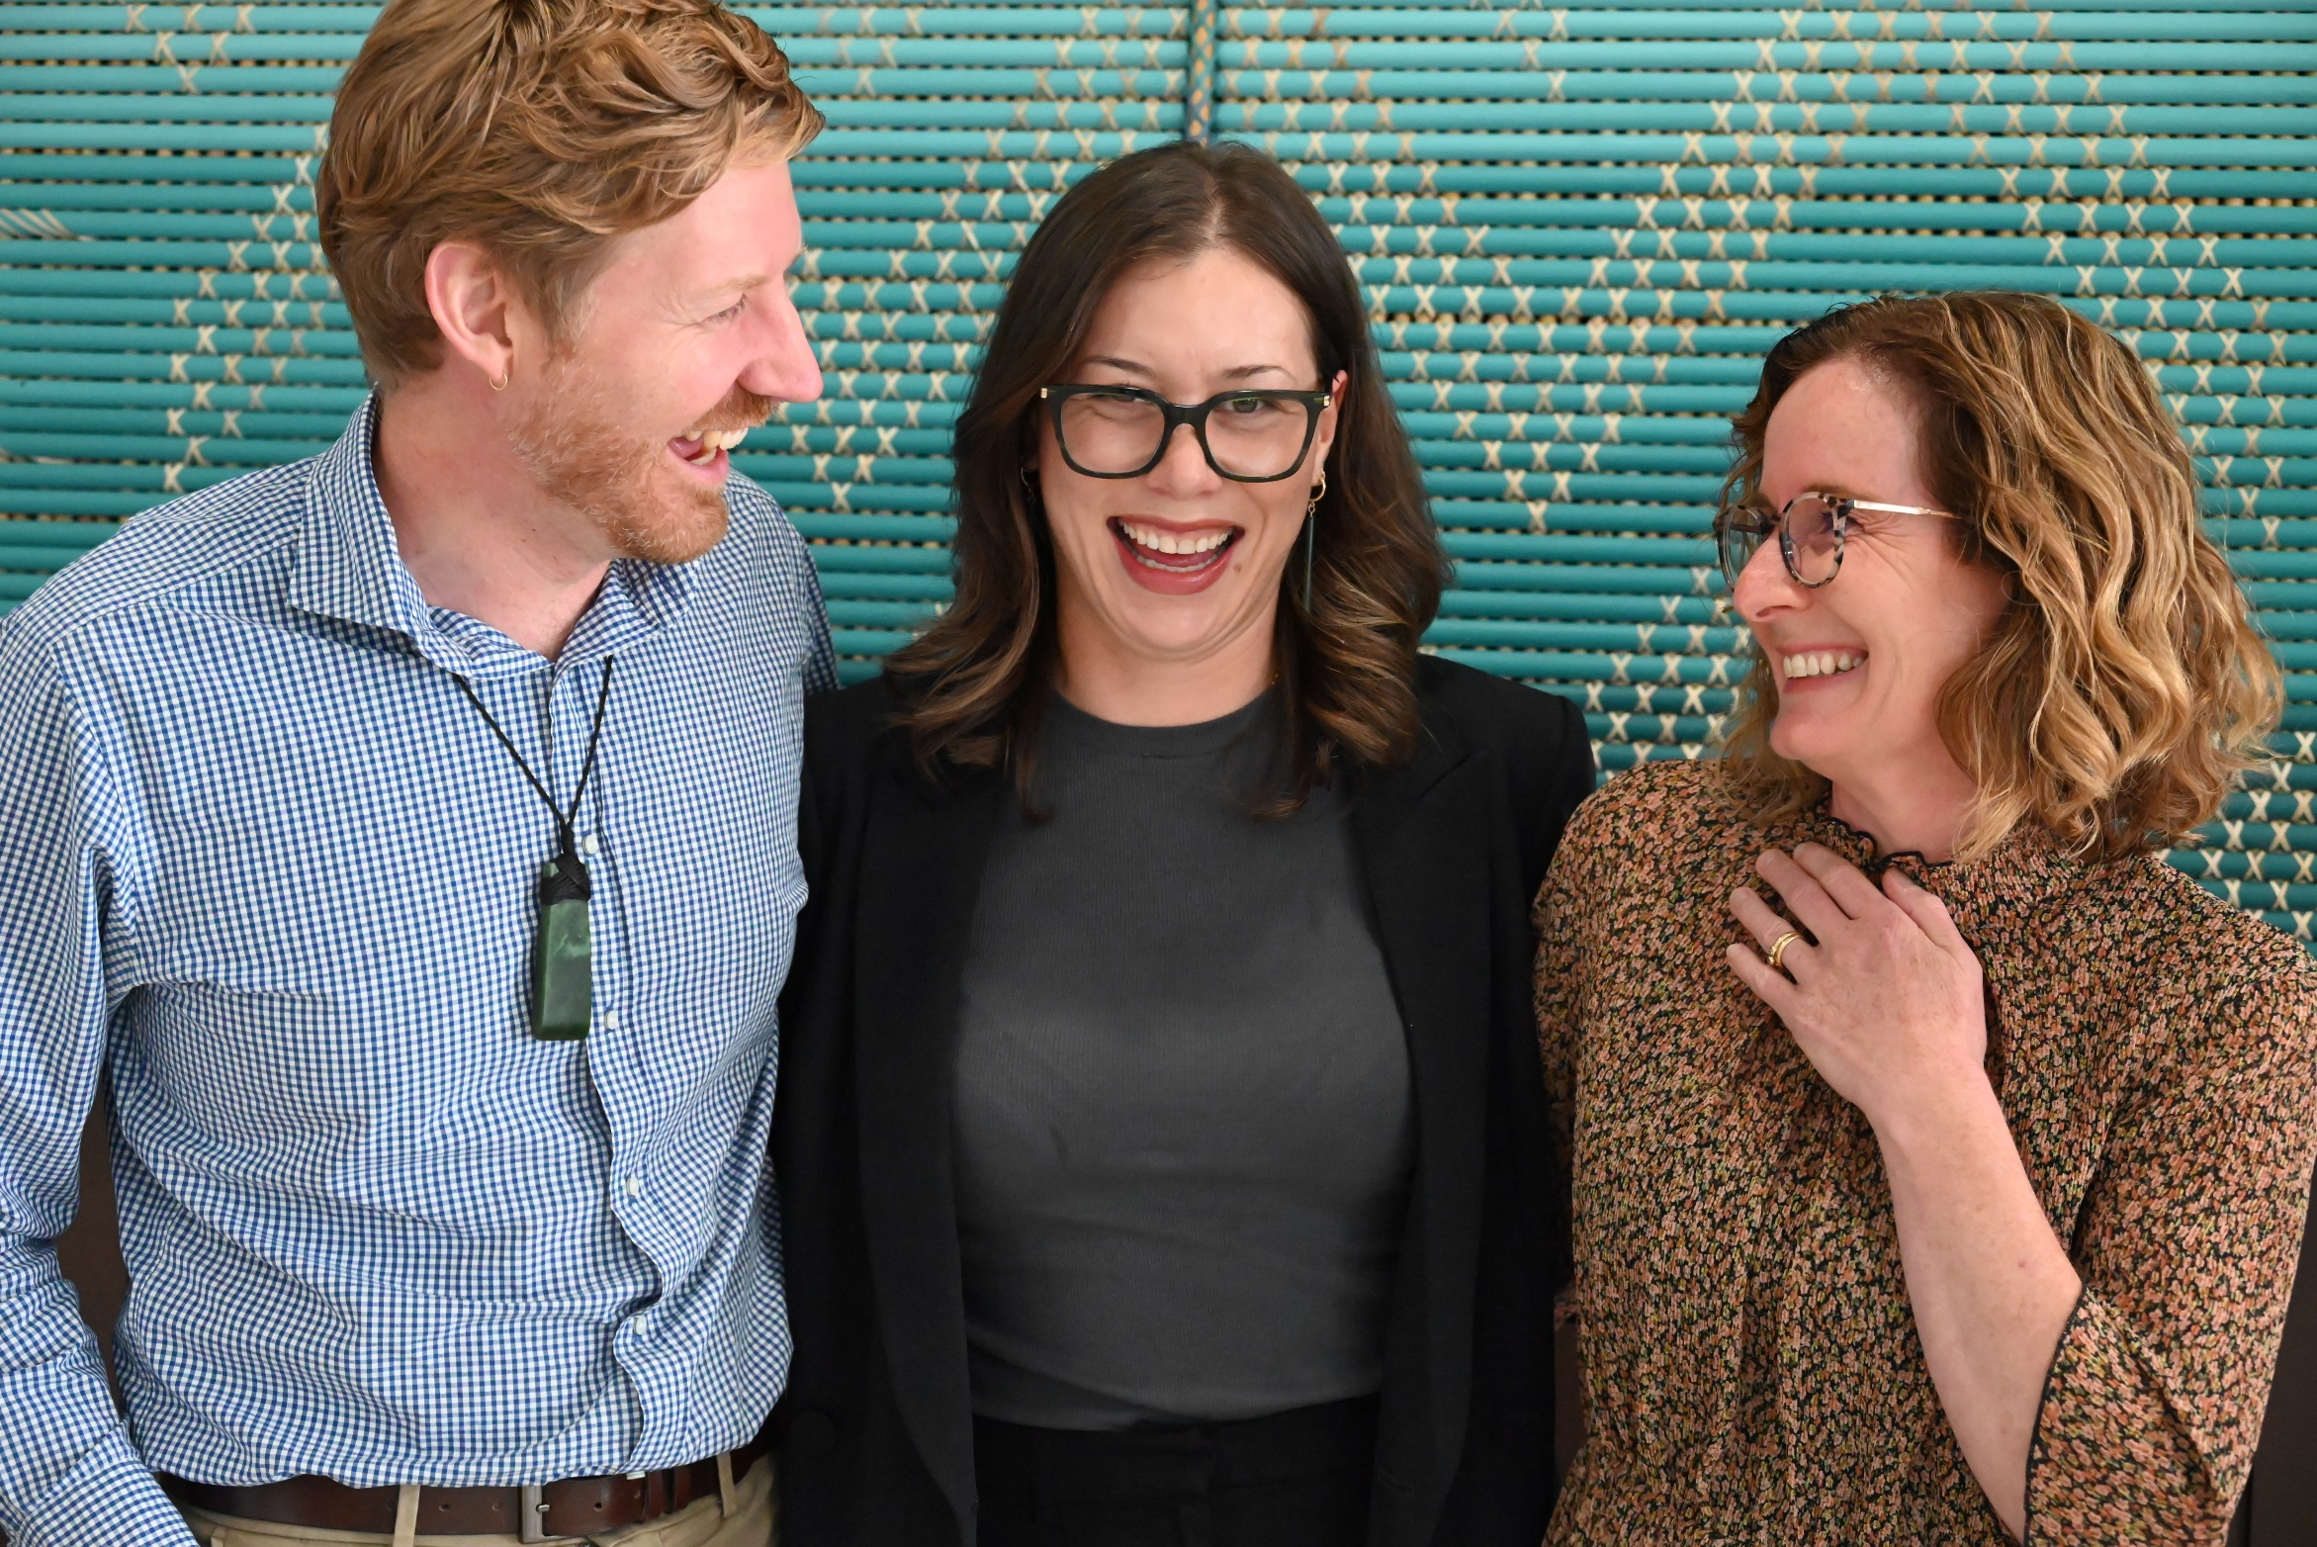
Ngāti Whātua Ōrākei
Ko wai mātou?
Notes:
We are a legal team who knows how to laugh.
I am Natasha Strong, my ancestors were refugees from Romania and [ ] in, I grew up in Ōtautahi Christchurch but have lived in Tāmaki Makaurau for a number of years .
I am Jason Cooper, my ancerstors were missionaries from England to Australia in 1860s on my father’s side, and from England to New Zealand in the late 1960s on my mother’s side.
This is our legal intern Eden Irvine who is working with us part-time while she finishes her law degree at Otago University.

Slide 4
Setting our Intention
Ngāti Whātua Ōrākei

Slide 5
Ngāti Whātua Ōrākei
Context and Drivers
Estimates value the Māori economy at $70 billion, and it is forcast to grow to $100 billion by 2030
Iwi are becoming key investors and business partners as they recieve and grow their settlements
Many Māori are realising their mana motuhake through setting up their own businesses
Organisations are seeking to understand and strengthen their relationship with Māori, and some simply want to engage in the commercial opportunities presented by the Māori economy

Slide 6
What do in-house lawyers need to consider when contracting with iwi or Kaupapa Māori organisations, and how is it different from other forms of contracting?
Ngāti Whātua Ōrākei
Define your relationship goals | Is this purely transactional or are you looking for more? Has the iwi / kaupapa Māori contracting party indicated a desire to do things in a kaupapa Māori way?
Look in the mirror | How ready is your organisation for a deeper relationship? What preparation has your organisation done and do you have buy-in?
Introduce yourself and your organisation | Prepare for and engage in whakawhanaungatanga
Think about the long term | How do your products, services, goals reflect kaitiakitanga / a long term world view?
Collective vs individual world view | Consider how a collective world view might impact your counter party’s interests, goals, and motivations. Will your engagement enable or harm Māori aspirations
Research your counter party | Be equipped with some background knowledge about the whakapapa of the organisation / iwi and key people you will be working with

Slide 7
How could this impact negotiations?
Ngāti Whātua Ōrākei
Kanohi ki te kanohi | Meet face to face. Start with the relationship building before moving to the documentation.
Tikanga may play a role | Check in advance with the other party, and be prepared as best you can for: Pōwhiri / Mihi Whakatau Karakia Waiata Whakawhanaungatanga
Heirarchy is important | Rangatira ki te rangatira
Relationship holders are important | Involve your internal Māori advisors as a key stakeholder if you have them. Aim to have a consistent point of contact who has good EQ.

Slide 8
How could this impact your documentation?
Ngāti Whātua Ōrākei
Background Section / Recitals
Values / Uara
Language / Reo
A Te Tiriti framing may be appropriate depending on your context
Intellectual Property
Confidentiality
Dispute Resolution

Slide 9
What are the opportunities and challenges that come with contracting in a culturally informed manner?
Ngāti Whātua Ōrākei

Slide 10
Ngā Mihi Natasha Strong and Jason Cooper

